Slide 1
How to live before you die.

Slide 2

I will explain it through few topics
Embracing life to the fullest.
Be present in the moment.
Don’t wait for tomorrow.
Setting Meaningful Goals.

Slide 3
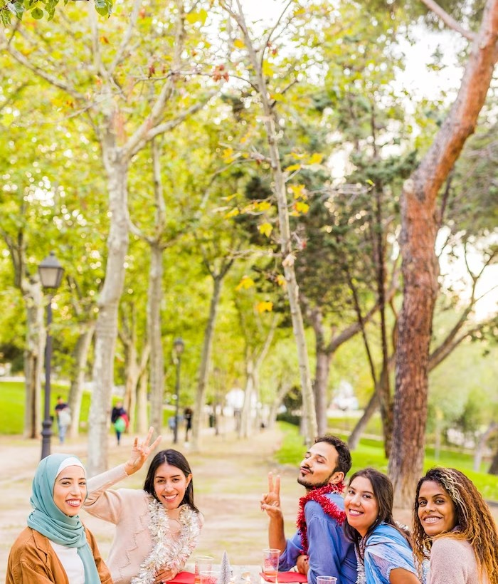
Embracing life to the fullest.
Welcome to Embracing Life:

Slide 4

Be present in the moment.
Imagine you’re watching a movie and you’re so busy in it that you forget everything else. It’s present is similar in real life.

Slide 5

Don’t wait for tomorrow.
So the message is to start working today instead of waiting for the future.

Slide 6

Setting Meaningful Goals.
By taking action immediately, you can achieve your goals and make the most out of the present moment.

Slide 7
CONCLUSION
I think all the points discussed above should be kept in mind.
Because a person is useful only when he benefits people and can reach the goal of life.

Slide 8

THANKS

